Slide 1
Secure Your Cloud with Confidence
Deep Dive into
Azure Security Management
Travis Guinn

Slide 2
Agenda
Microsoft Entra
Authentication Methods
Single Sign On
Hybrid Management

Slide 3
Introduction to Azure AD

Slide 4



Identity is the control plane for digital transformation
Microsoft
Azure AD
Notes:
Before we dive into new features, we wanted to talk about current technology trends, and identity role in digital transformation.
The network perimeter is disappearing
Resources are moving to the cloud
An average company is seeing an explosion of devices and applications with an average of 140 apps used by enterprises
People have multiple identities, and they connect from anywhere, using multiple devices.
Identity is a control plane for digital transformation
In this world your cloud identity system cloud is your control plane that can connect everything, give you visibility to your entire digital estate, ensure that only right people have the right access to the right resources, and keep the bad players out.
You are leading digital transformation to help your companies get ready for the opportunities in the cloud era, and reinvent the way we work

Slide 5
Azure Active Directory—the world’s largest cloud identity service
Thousands of organizations, millions of active users, billions of daily requests
100 K +
250 M +
30 B +
Enterprise customers
Using Azure AD
Azure AD
Monthly active users
Azure AD
Daily authentication requests
Notes:
Microsoft is one of the largest identity providers. The scale of our solution is vast:
Azure AD is a truly global identity service that operates at hyper-scale, with over 1.34 B identities
Over 100 thousand organizations trust Azure AD, including 90 % of Fortune 500
We manage over 250M Monthly active users, with an average of 30 billion daily authentication requests [For comparison, Okta has about 8B authentications PER YEAR.] and 44M MAU connecting to 3rd party apps

Slide 6








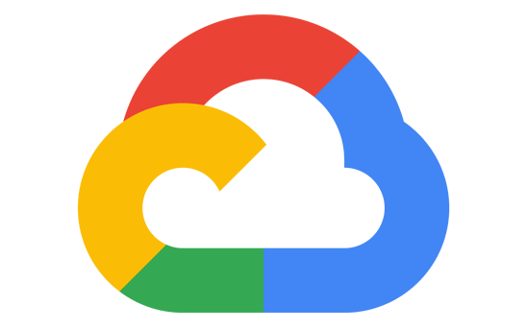


Unified identity management
Manage all your identities and access to all your applications across your hybrid environment
Employees
SaaS apps
Frontline workers
Cloud-hosted apps
Azure
Active Directory
Customers
On-premises
and web apps
HR user data
Partners
Active Directory

Slide 7







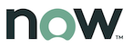






Connect your workforce to any app
SaaS apps
Cloud-hosted apps
Amazon
Web Services
Microsoft
Azure
Google
Cloud
Single sign-on
HR systems
Azure AD
App delivery controllers & networks
Azure AD
App Proxy
External identities
Active Directory
On-premises perimeter-based networks

Slide 8

Provide a common identity for your users
Manage your hybrid identity from the cloud for greater security and control
Sync identities with Azure AD Connect so users gain a common identity for access to resources no matter where they are
Cloud identities
Apps & resources
Azure AD
Embrace cloud authentication and upgrade from AD FS, reducing your
on-premises footprint
Azure AD Connect
Identify & resolve vulnerabilities
and assess threats efficiently with Microsoft Defender for Identity and advanced protection with Azure AD
Microsoft Defender
for Identity
On-prem identities
Active Directory

Slide 9

Directory provisioning tools
Next generation sync solution
Azure AD Connect cloud sync
Support for common Azure AD hybrid scenarios
Minimal infrastructure investment
Quick to deploy and simple setup, managed from Azure AD
High availability / resilient architecture
Support for complex scenarios (mergers and acquisitions)
Co-existence with Azure AD Connect
Frequent provisioning cycles

Slide 10
Azure AD Integration Scenarios
Cloud Identity
Synchronized Identity
Federated Identity
Azure Active Directory
Azure Active Directory
Azure Active Directory
Azure AD Connect sync
Azure AD Connect cloud sync
Azure AD Connect sync (cloud sync)
Federation
Azure Active Directory
Active Directory
Active Directory
Independent cloud identities.
Single identity, enabling a same or single sign-on experience with Password Hash Sync or Pass-through Authentication*.
Single federated identity, enabling single-sign-on experience and on-premises multi-factor authentication options

Slide 11
Hybrid authentication options overview
Password Hash Synchronization (PHS)
Pass-Through Authentication (PTA)
Federated Authentication
Azure Active Directory
Azure Active Directory
Azure Active Directory
Azure AD Connect sync
Azure AD Connect cloud sync
Azure AD Connect sync
Authentication Agent
Azure AD Connect sync (cloud sync)
Federated Identity Provider
Active Directory Domain Services
Active Directory Domain Services
Active Directory Domain Services
Authentication performed by Azure AD using synchronized password hashes
Authentication performed by AD DS via authentication agent that looks for requests via outbound communication
Authentication performed by AD DS via federated identity provider
* PTA is not available for Azure AD Connect cloud sync.

Slide 12
Demo

Slide 13
Authentication Methods

Slide 14

Multi-factor authentication
Verify user identities with strong authentication
Including passwordless technology
Microsoft
Authenticator
Windows Hello
FIDO2 Security key
Biometrics
Multi-factor
authentication
prevents 99.9%
of identity attacks
We support a broad
range of multi-factor
authentication options
Push Notification
Soft
Tokens OTP
Hard
Tokens OTP
SMS,
Voice
Notes:
Microsoft recommends passwordless authentication methods such as Windows Hello, FIDO2 security keys, and the Microsoft Authenticator app because they provide the most secure sign-in experience. Although a user can sign-in using other common methods such as a username and password, passwords should be replaced with more secure authentication methods.
Azure AD Multi-Factor Authentication (MFA) adds additional security over only using a password when a user signs in. The user can be prompted for additional forms of authentication, such as to respond to a push notification, enter a code from a software or hardware token, or respond to an SMS or phone call.
To simplify the user on-boarding experience and register for both MFA and self-service password reset (SSPR), we recommend you enable combined security information registration. For resiliency, we recommend that you require users to register multiple authentication methods. When one method isn't available for a user during sign-in or SSPR, they can choose to authenticate with another method. For more information, see Create a resilient access control management strategy in Azure AD.

Slide 15




Deploy the most secure, usable & cost-effective methods
Bad: Password
Good: Password +
Better: Password +
Best
123456
qwerty
password
iloveyou
Password1
SMS
Push notification
Windows Hello
Software
Tokens OTP
FIDO2 security key
(Preview)
Voice
Hardware Tokens OTP
(Preview)
Microsoft Authenticator
(Preview)

Slide 16
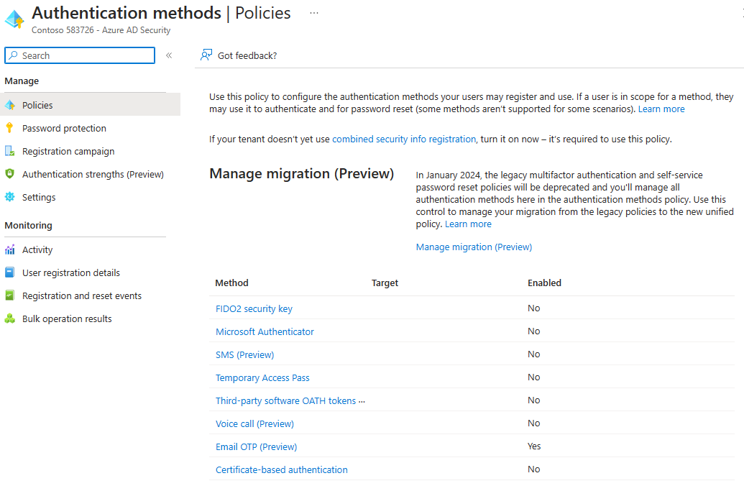
Authentication methods policy
Notes:
The Authentication methods policy is the recommended way to manage authentication methods, including modern methods like passwordless authentication. Authentication Policy Administrators can edit this policy to enable authentication methods for all users or specific groups.
Methods enabled in the Authentication methods policy can typically be used anywhere in Azure AD - for both authentication and password reset scenarios. The exception is that some methods are inherently limited to use in authentication, such as FIDO2 and Windows Hello for Business, and others are limited to use in password reset, such as security questions. For more control over which methods are usable in a given authentication scenario, consider using the Authentication Strengths feature.

Slide 17
Demo

Slide 18
Enterprise Applications & SSO

Slide 19



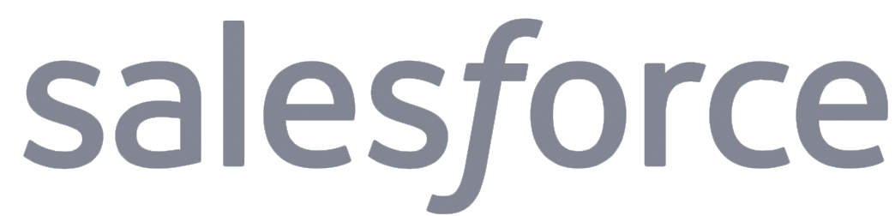




Identity
Is the new control plane
On-premises /
Private cloud
Notes:
© Microsoft Corporation. All rights reserved. MICROSOFT MAKES NO WARRANTIES, EXPRESS, IMPLIED OR STATUTORY, AS TO THE INFORMATION IN THIS PRESENTATION.
3/27/2023 3:17 PM
19

Slide 20
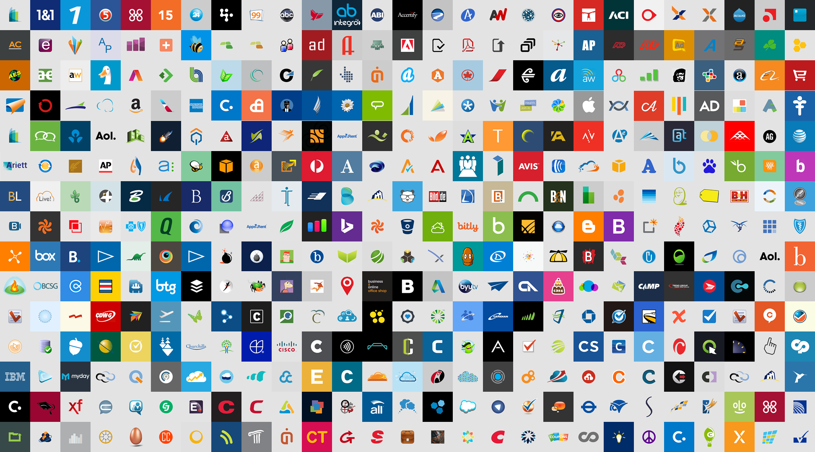
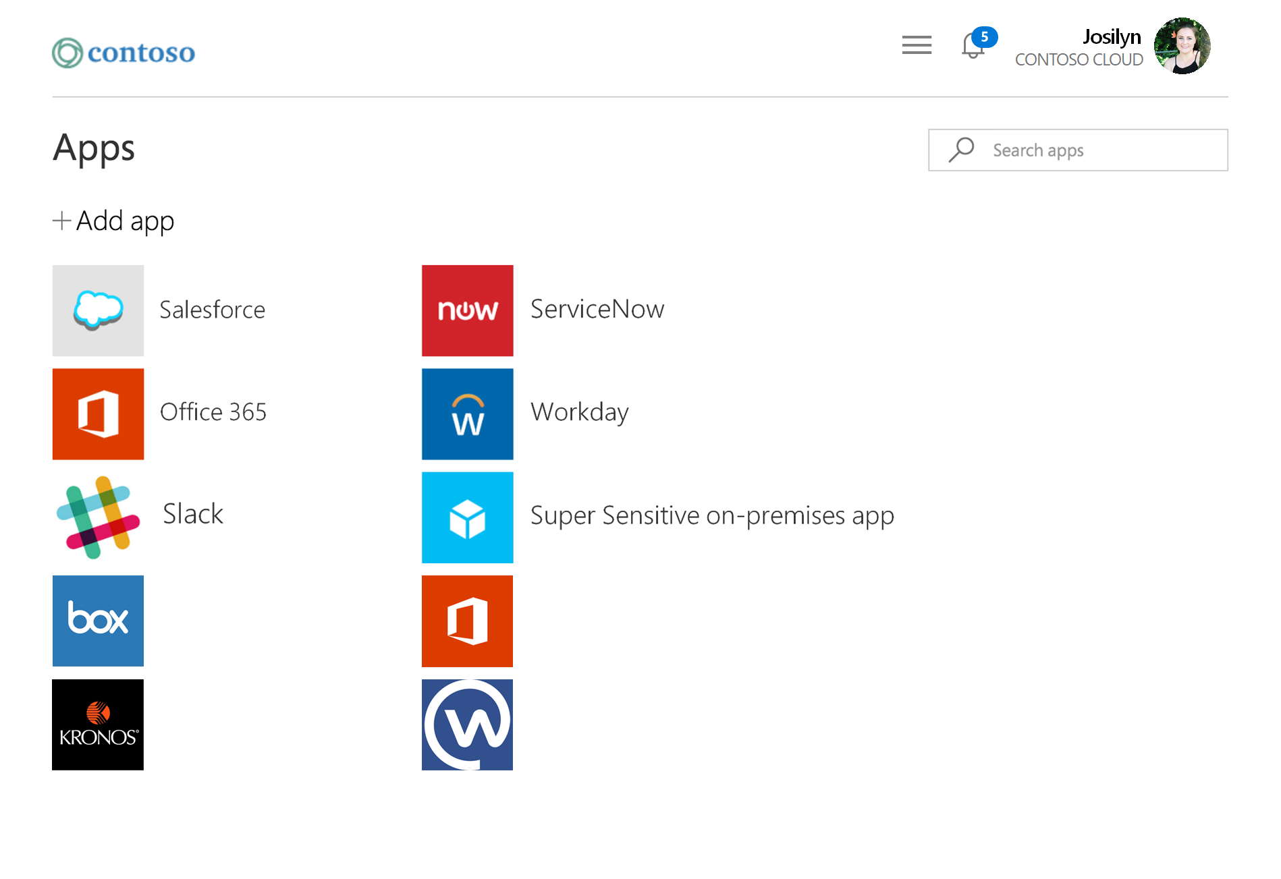
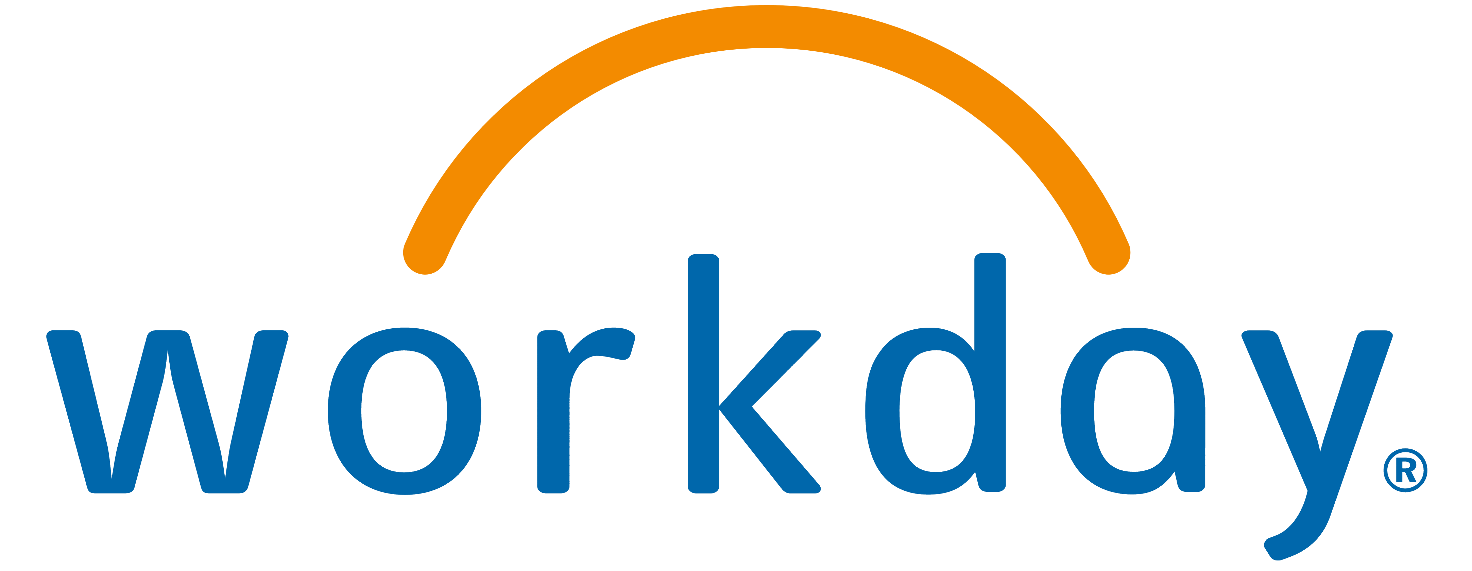
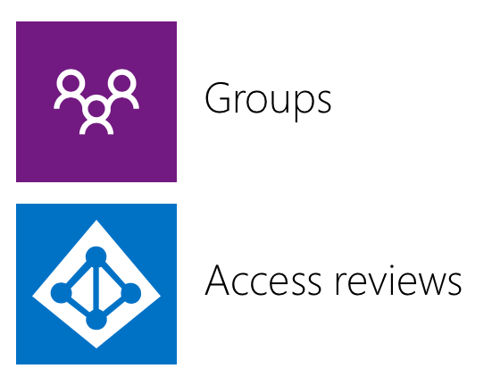
Access
panel
HR app
Dynamic groups
Microsoft Azure
Active Directory
Box
Office 365 SharePoint Online
Kronos
Workplace by Facebook
On-
premises

Slide 21
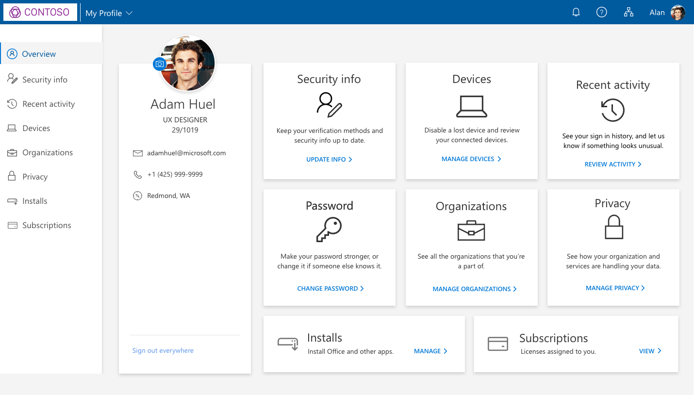
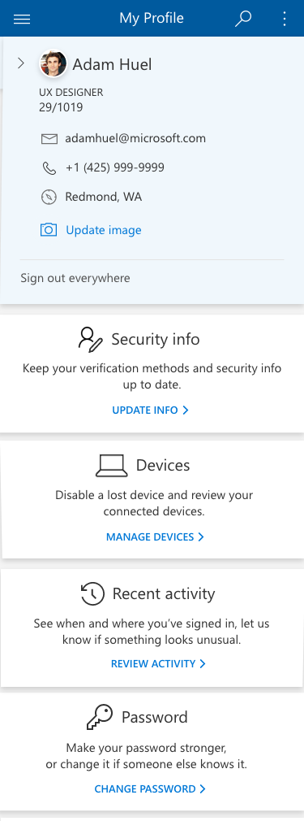
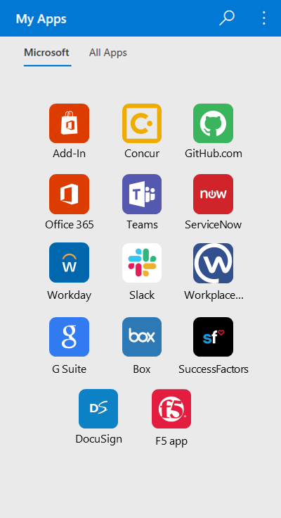
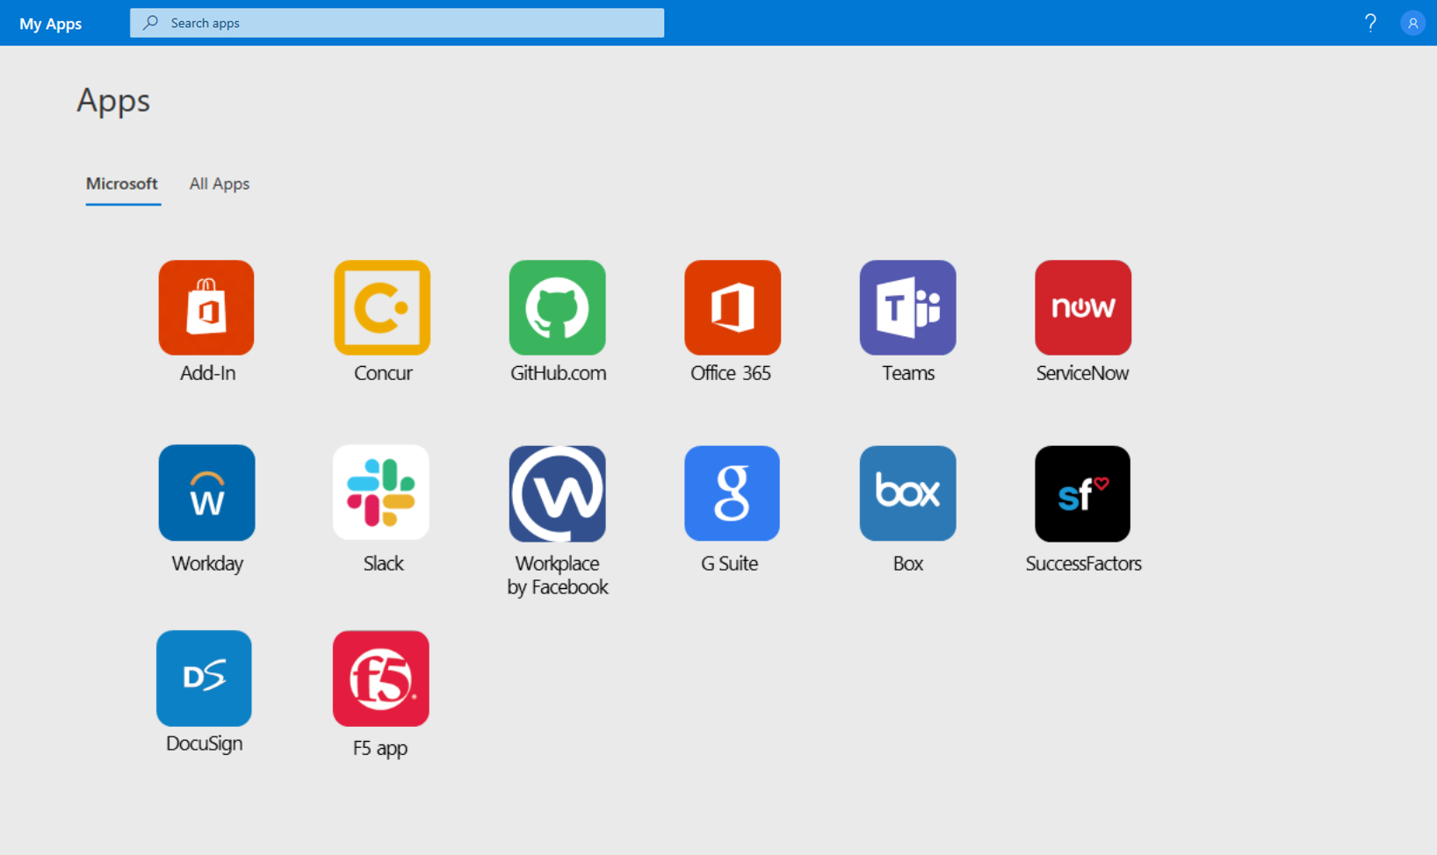
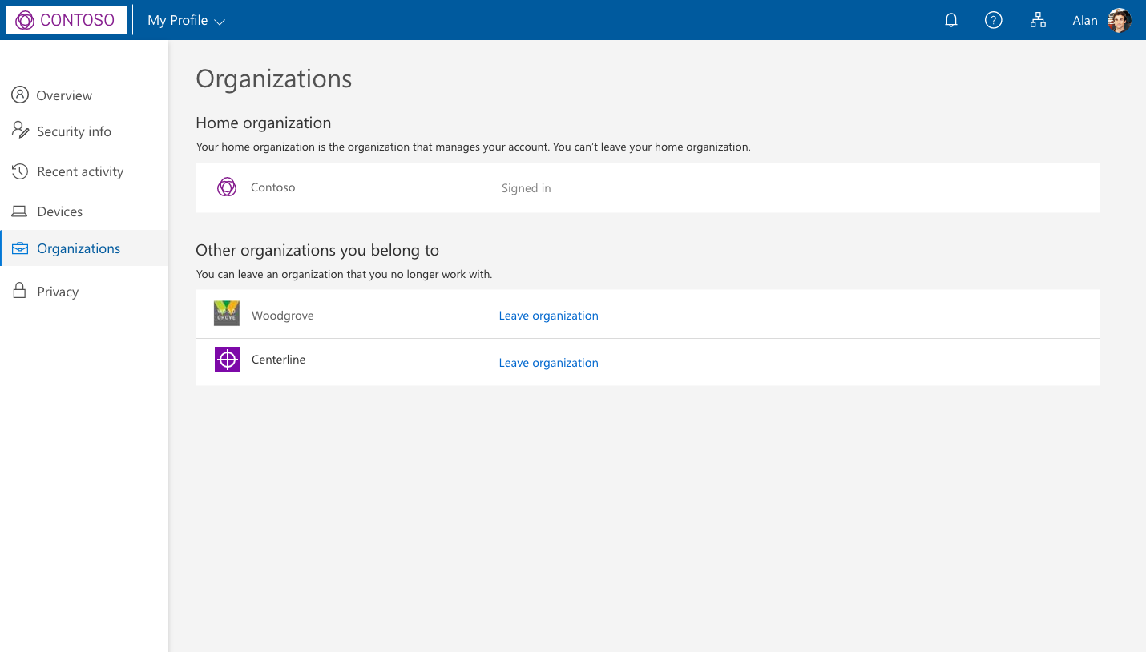
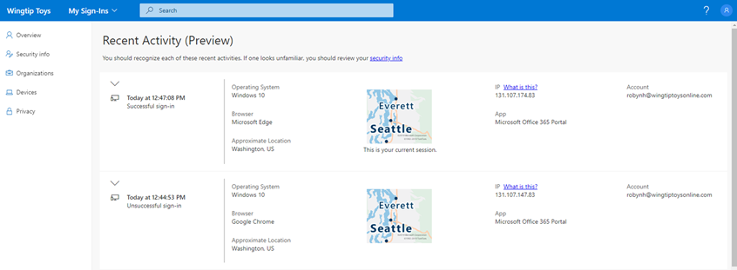
Azure AD · My Apps + My Account + My Sign-Ins
My Account experience
My Apps portal experience
My Sign-Ins experience
[My Account screenshot]

Slide 22
Demo

Slide 23
Hybrid Identity

Slide 24
Unified identity management
Manage all your identities and access to all your applications in a central location for cloud and on-premises to improve visibility and control
Provide a common identity for your users and manage your hybrid identity from the cloud
Connect any app in
any cloud or datacenter
across your hybrid environment
Efficient identity management
and administration for employees, partners, and customers
Notes:
You can only secure what you know and what you have visibility into. Azure AD provides a single identity system for your cloud and on-premises apps, to simplify management, tighten control, and close critical security gaps. Use easy sync tools to connect to Active Directory, on-premises apps and cloud HR systems.
Provide a common identity for your users. Manage your hybrid identity from the cloud for greater security and control. Sync your on-premises identities, and HR systems data in one central control plane.
Connect any app in any cloud or datacenter. Manage your users and their access to any app in any cloud or datacenter across your hybrid environment, from a single cloud portal. Manage legacy on-premises applications with Azure AD Application Proxy or with secure hybrid access partnerships alongside your cloud apps and custom-built apps. Improve your control and visibility, while simplifying the experience for users.
Efficiently manage external identities. Manage customers and partners with External Identities in the cloud to deliver flexible, secure access to apps and services such as SharePoint Online and Office 365 applications, in addition to any other SaaS apps like ServiceNow or Adobe, on-premises applications from SAP and Oracle, and custom-built apps. Enable users to bring their own identity for frictionless authentication.
EMS Overview
© 2014 Microsoft Corporation. All rights reserved. Microsoft, Windows, Surface and other product names are or may be registered trademarks and/or trademarks in the U.S. and/or other countries. The information herein is for informational purposes only and represents the current view of Microsoft Corporation as of the date of this presentation. Because Microsoft must respond to changing market conditions, it should not be interpreted to be a commitment on the part of Microsoft, and Microsoft cannot guarantee the accuracy of any information provided after the date of this presentation. MICROSOFT MAKES NO WARRANTIES, EXPRESS, IMPLIED OR STATUTORY, AS TO THE INFORMATION IN THIS PRESENTATION.
3/27/2023
24

Slide 25

Provide a common identity for your users
Manage your hybrid identity from the cloud for greater security and control
Sync identities with Azure AD Connect so users gain a common identity for access to resources no matter where they are
Cloud identities
Apps & resources
Azure AD
Embrace cloud authentication and upgrade from AD FS, reducing your
on-premises footprint
Azure AD Connect
Identify & resolve vulnerabilities
and assess threats efficiently with Microsoft Defender for Identity and advanced protection with Azure AD
Microsoft Defender
for Identity
On-prem identities
Active Directory
Notes:
Talk track:
Azure AD simplifies the way you manage and secure your applications by providing one identity system for your cloud and on-premise apps. You can add your SaaS applications, on-premise applications, and line-of-business (LOB) apps to Azure AD.
A critical step towards starting a Zero Trust journey is consolidating secure access to all applications whether they are on-prem or in the cloud​.
To get started, Azure AD can be easily synchronized with on-premises Active Directory, connected to cloud HR systems, and enabled for external users.​

Slide 26
Connect your workforce to any app
SaaS apps
Cloud-hosted apps
Amazon
Web Services
Microsoft
Azure
Google
Cloud
Single sign-on
HR systems
Azure AD
App delivery controllers & networks
Azure AD
App Proxy
External identities
Active Directory
On-premises perimeter-based networks
Notes:
Talk track:
With that you can enable Single Sign On to all apps including SaaS apps, custom built cloud apps, and on-prem apps. ​
For on-premises apps you can choose between Azure AD Application Proxy or one of the Secure Hybrid Access integrations from Akamai, Citrix, F5 or Zscaler. These solutions help customers access legacy auth based applications that use protocols like Header-based and Kerberos authentication. We continue to make the roll-out for integrated solutions easier – a great example is F5 “Easy” button in the Azure portal to simplify app configuration.

Slide 27





Efficiently manage external identities
Grant secure access to your employees, partners, and customers and facilitate B2B collaboration
Collaboration
Employee
App access
Policy engine
SECURITY
Partner
Customer
CUSTOMIZATION
Notes:
Talk Track:
Azure AD External Identities is a set of capabilities that let you share your resources or apps with users outside of your organization. There are two main reasons you might need to connect with external users:
- Share your Azure AD apps and resources for collaboration. You can invite external users into your own tenant as "guest" users that you can assign permissions to while letting them to use their existing credentials. Now we've added self-service sign-up user flows that you can offer to your external users, along with other features that were previously only available in Azure AD B2C.
- Scale your apps to consumers, customers, and citizens (Azure AD B2C). If you're creating customer-facing apps, you can use Azure AD as your directory and identity system for consumers, who can sign in with an identity they’ve already established. You can customize and control the user experience for sign-up, sign-in, and profile management.
The same billing model now applies to all Azure AD External Identities capabilities. Pricing is based on monthly active users (MAU), which is the count of unique users with authentication activity within a calendar month. This MAU billing model applies to both Azure AD guest user collaboration (B2B) and Azure AD B2C tenants.
Managing access for external users separately across multiple directories can leave critical gaps in security. Managing these identities from Azure AD improves visibility into external users’ access and extend secure adaptive access policies for fine-grained access control. And users can bring their own identity provider, not just Microsoft.
Easily invite partners to collaborate and automate how you manage their access. Facilitate collaboration with any user you need to invite to a group or interact with in an application with secure sharing in Teams and SharePoint.
Azure AD also includes a robust set of capabilities to manage customer, consumer, and citizen access to your B2C apps. Personalize user journeys with built-in user flow templates and custom policies. Capture login, preference, and conversion data for customers. Provide branded (white-label) registration and login experiences, while enabling easy sign in for users with any personal, work or school, social or local accounts through Azure AD B2C.

Slide 28
Conditional Access & Identity Protection

Slide 29
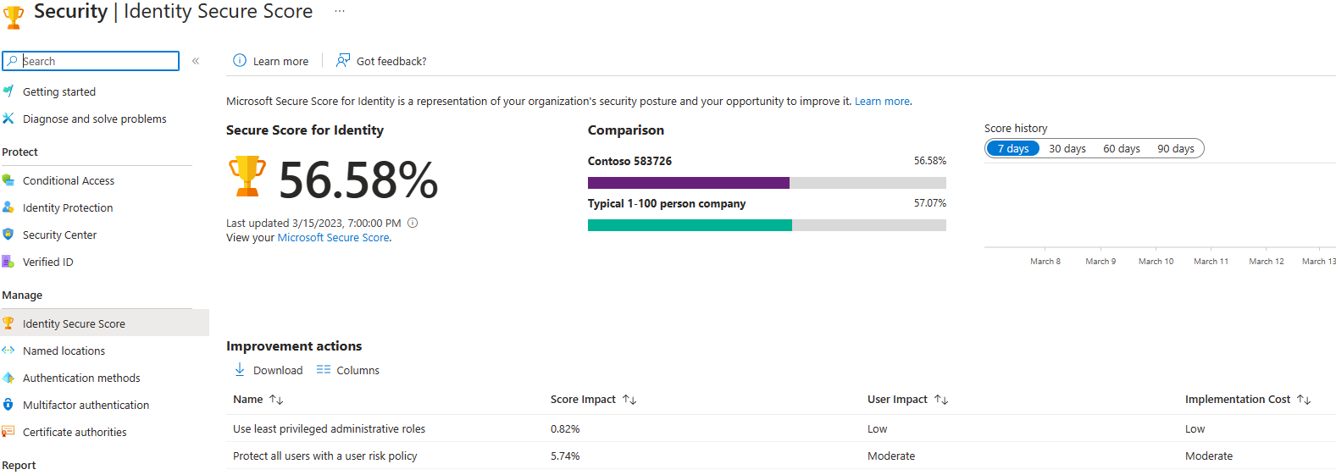
Identity Secure Score
Notes:
How secure is your Azure AD tenant? If you don't know how to answer this question, this article explains how the identity secure score helps you to monitor and improve your identity security posture.
What is an identity secure score?
The identity secure score is percentage that functions as an indicator for how aligned you are with Microsoft's best practice recommendations for security. Each improvement action in identity secure score is tailored to your specific configuration.
How does it work?
Every 48 hours, Azure looks at your security configuration and compares your settings with the recommended best practices. Based on the outcome of this evaluation, a new score is calculated for your directory. It’s possible that your security configuration isn’t fully aligned with the best practice guidance and the improvement actions are only partially met. In these scenarios, you will only be awarded a portion of the max score available for the control.
Each recommendation is measured based on your Azure AD configuration. If you are using third-party products to enable a best practice recommendation, you can indicate this configuration in the settings of an improvement action. You also have the option to set recommendations to be ignored if they don't apply to your environment. An ignored recommendation does not contribute to the calculation of your score.
As improvements are made to your identity security posture, the more the score increases. Global admins, security admins, security reader accounts can access the Identity Secure Score located in the Azure portal in Azure AD under Identity Score. To improve your score, there are some top recommendations to follow including strengthen your credentials, reduce your attack surface area, automate threat response, increase your awareness of auditing and monitoring, and enable more predictable and complete end-user security with self-help.

Slide 30
Demo

Slide 31
Protect resources with Conditional Access
Enable Zero Trust with strong authentication and adaptive policies
Signals
Verify every access attempt
Apps and data
User and location
Device
Allow access
Require MFA
Limit access
Application
Real-time risk
Password reset
Monitor access
Notes:
Conditional Access with Identity Protection is the best way to secure your identities and keep the bad guys out.
What it is: Conditional Access is an intelligent policy that allows you define conditions for how users authenticate and gain access to apps and data.
How it works: Identity Protection with Conditional Access takes in over 171TB of identity-related security signals - like user behavior, location, state of device, application being accessed, and the risk score for user and sign-in. Using machine learning, we analyze the signals and determine the appropriate policy - allow, limit, block access or request additional verification.
For example, you might have a policy that requires MFA if the user is accessing from a new location. So when a user signs in from unfamiliar location they get an additional verification prompt before they are given access.
Other notes
What it is: It’s critical that only the right people with the right resources on secure devices can access your data from anywhere. Microsoft Conditional Access is an intelligent policy engine built for this challenge. Its robust controls allow you to define specific conditions for how users authenticate and gain access to apps and data. You can customize and manage automated policies and get reporting on the policies applied for each sign-in.
Microsoft Conditional Access gives you the power to enforce the core principle of Zero Trust—never trust, always verify. The Zero Trust security model relies on a security policy engine to make access decisions you can enforce throughout the digital estate. Microsoft Conditional Access enables organizations to fine-tune access policies based upon contextual user, device, location, and session risk information. That gives you better control on how users access corporate resources.​ You can then use additional challenges such as multi-factor authentication (MFA), Terms of Use, or access restrictions to decide whether to allow, deny, or control access.
How it works: Conditional Access takes in over 40TB of identity-related security signals—including user behavior, location, state of device, application being accessed, and the risk score of the sign-in. Using machine learning, our technology analyzes the signals and determines the appropriate policy to apply for access to a resource, such as allowing, limiting, or blocking access, or additional verification measures.
For example, you might have a policy that requires MFA if the user attempts access from a new location. When the user enters their credentials, an MFA challenge such as a push notification from the Microsoft Authenticator app prompts them to prove their identity before they are granted access.
These capabilities also extend to Azure. You can set Conditional Access policies to define conditions under which users can access cloud resources. Within Azure you also get access to MFA, Customer Lockbox, and role-based access control.
In today’s complex, modern work environment, Conditional Access provides protection without compromising productivity.

Slide 32
Demo

Slide 33

Identity protection
Intelligently detect and respond to compromised accounts
300%
increase in identity attacks over the past year
Real-time
detection
Automated
remediation
Connected
intelligence
Notes:
Talk track:
Based on Microsoft research, we’ve seen a 300-percent increase in identity attacks over the past year. While Conditional Access protects resources from suspicious requests, identity protection goes further by providing ongoing risk detection and remediation of suspicious user accounts. Identity protection keeps you informed 24/7 of suspicious user and sign-in behavior in your environment. Its automatic response proactively prevents compromised identities from being abused.
Real-time continuous detection: Monitor security alerts that affect your organization’s identities with continuous real-time and aggregated sign-in risk and user risk. Receive alerts when a user’s risk reaches a specified threshold.
Automated remediation: Set policies to automatically block sign-ins above a certain risk threshold (high, medium), review alerts, and automate responses for common scenarios.
Connected intelligence: Investigate risky users and sign-ins to address potential vulnerabilities. Go a step further if you see a suspicious incident and correlate alerts with other Microsoft solutions, which we’ll discuss next, for a more in-depth investigation and response.
Source: Microsoft Internal

Slide 34
Identity protection
Connected
intelligence
Proactive, AI-enhanced protection
Detects risk event and risky accounts
Automatic, real-time remediation
Provides recommendations to
improve security posture
Machine learning at a massive scale
Proactive
protection
Continuous
detection
Your organization
Logs
Relying parties
Self-reporting
Threat data
Behavior
Actionable insights and validation
Notes:
We think about user risk and sign-in risk:
User Risk
Calculated base on user risk events that are associated with the user's identity. Use these inputs :
Active risk events impacting the user
Risk level of these events
Whether any remediation actions have been taken
Sign In Risk
Likelihood that for a specific sign-in, someone else is attempting to authenticate with the user’s identity.
Real Time Indicators
How does Azure AD Identity Protection work?
Detect risk events and risky accounts (detect 6 types of risk events using ML and heuristic rules) --- More coming
Users with leaked credentials
Sign-ins from anonymous IP addresses
Impossible travel to atypical locations
Sign-ins from infected devices
Sign-ins from IP addresses with suspicious activity
Sign-ins from unfamiliar locations
Provide recommendations to improve security posture
Send notification of risk events
Provide easy access to remediation actions
Apply Conditional Access Policies

Slide 35
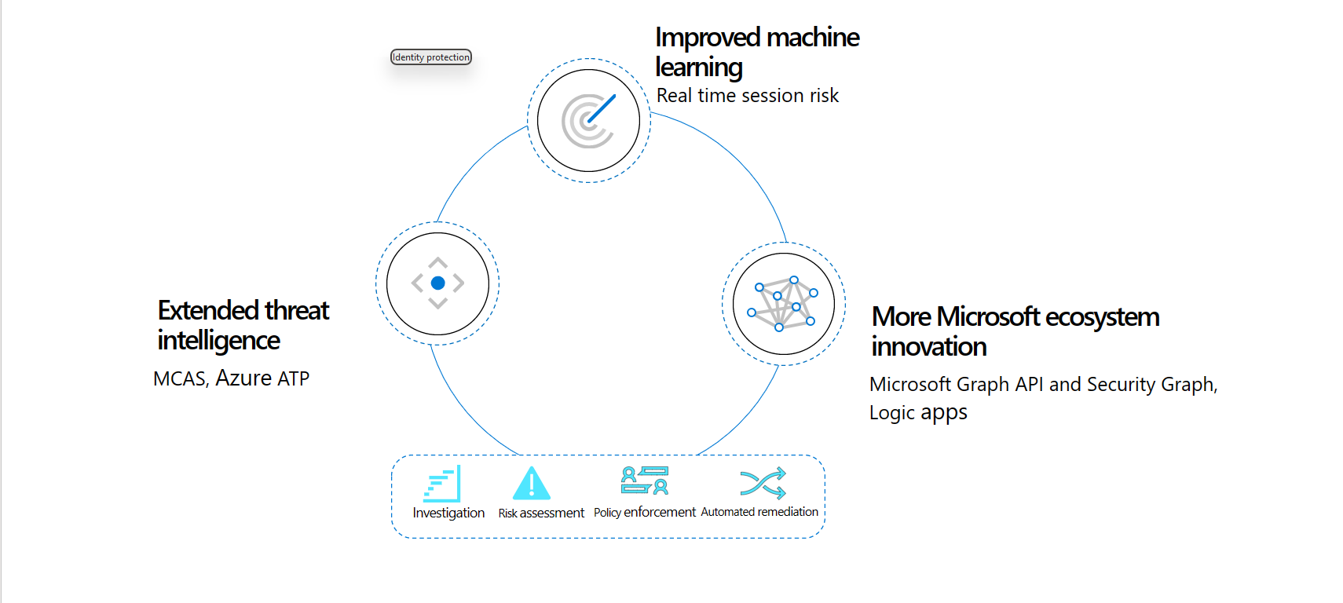
Identity Protection intelligently detects and responds to compromise

Slide 36
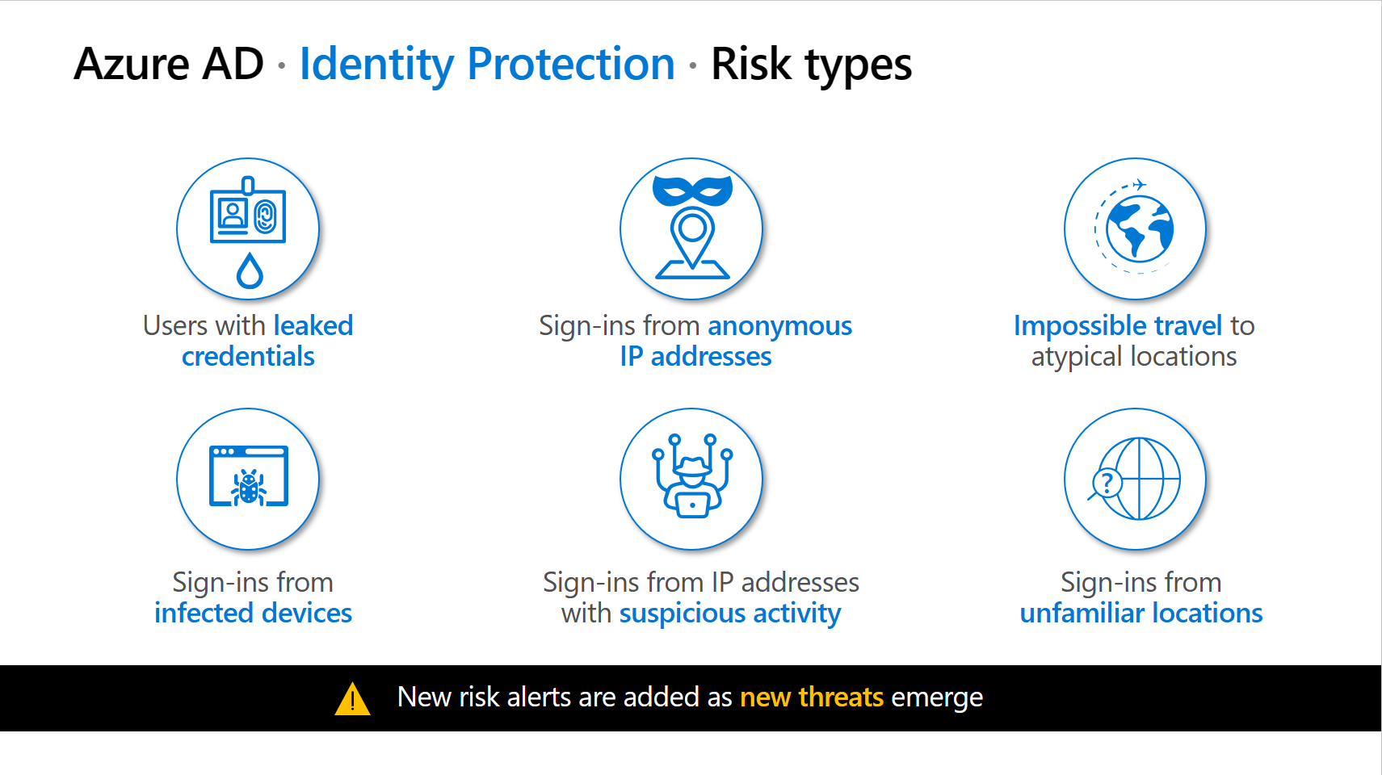

Slide 37
Detection Types
User-linked detections
Azure AD threat intelligence
Leaked credentials
Sign-in risk detections
Anonymous IP address
Atypical travel
Anomalous Token
Token Issuer Anomaly
Malware linked IP address
Suspicious browser
Unfamiliar sign-in properties
Admin confirmed user compromised
Malicious IP address
Suspicious inbox manipulation rules
Password spray
Impossible travel
New country
Activity from anonymous IP address
Suspicious inbox forwarding
Azure AD threat intelligence

Slide 38
Automatic Remediation
User Risk
Policy
Sign-in
Risky Policy
SSPR
(Self Service Password Reset)
MFA
(Multi Factor Authentication)

Slide 39






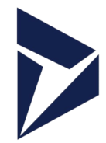









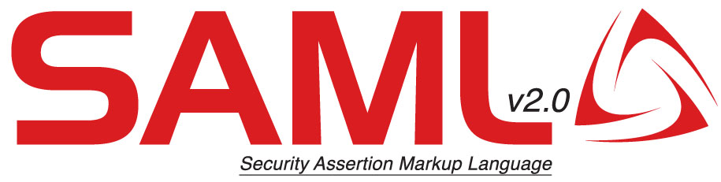









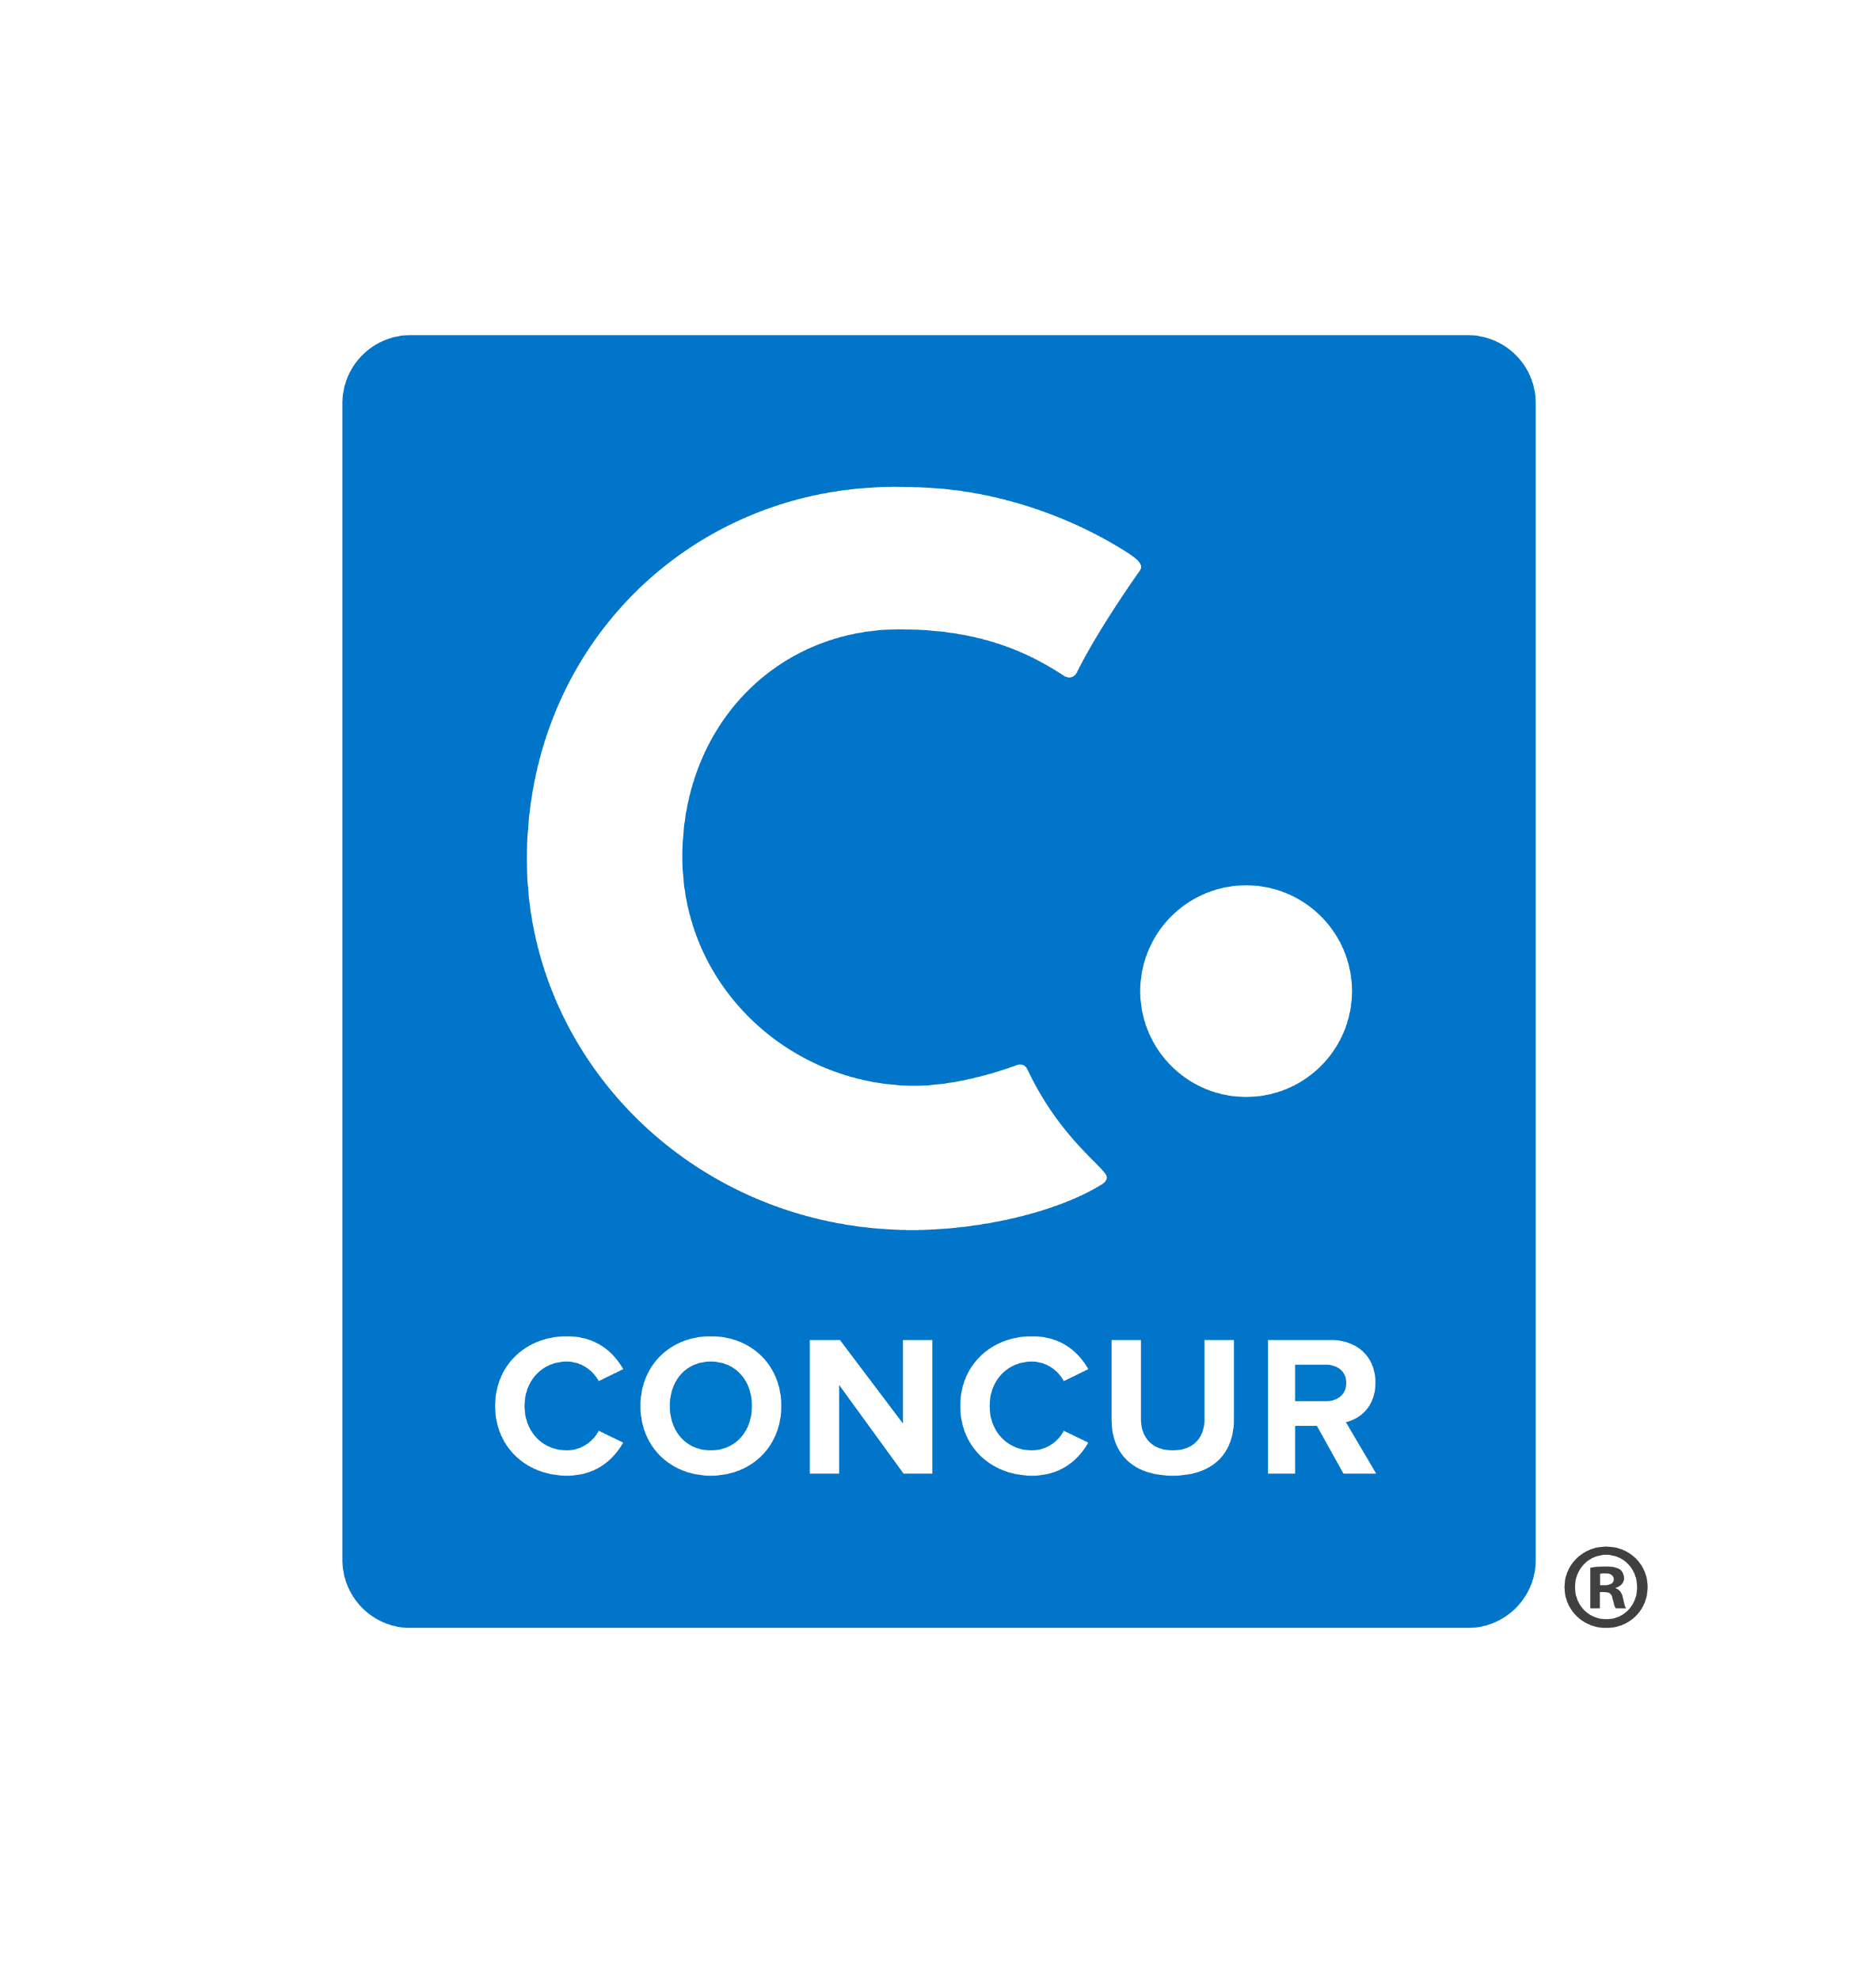





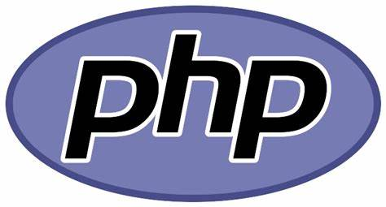
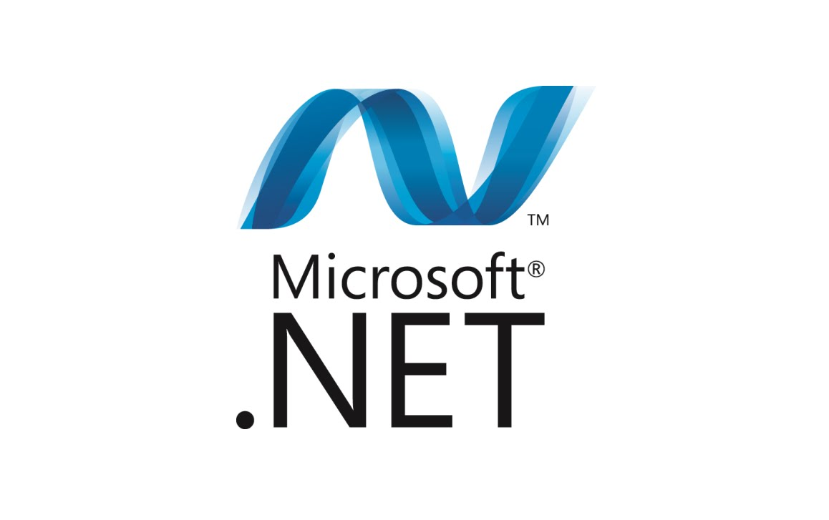
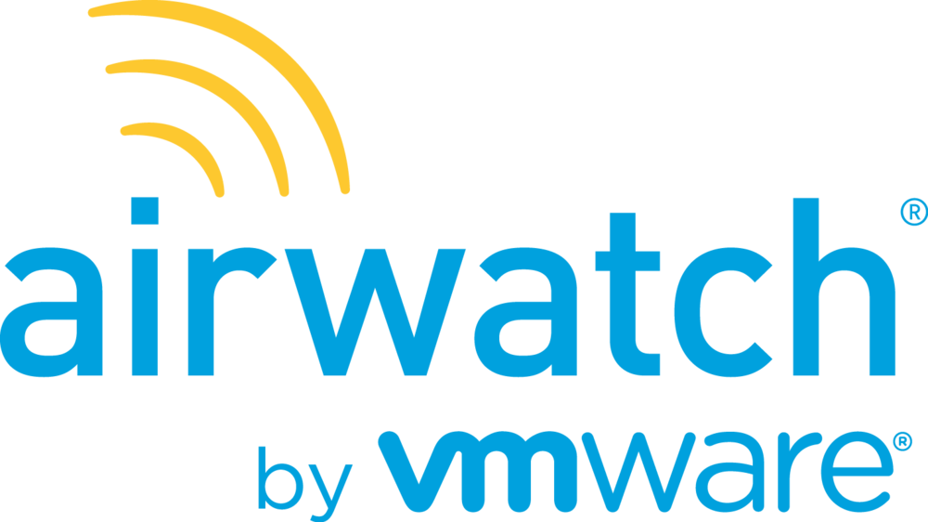


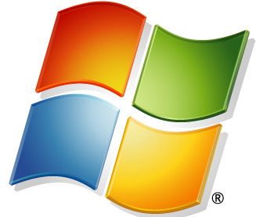
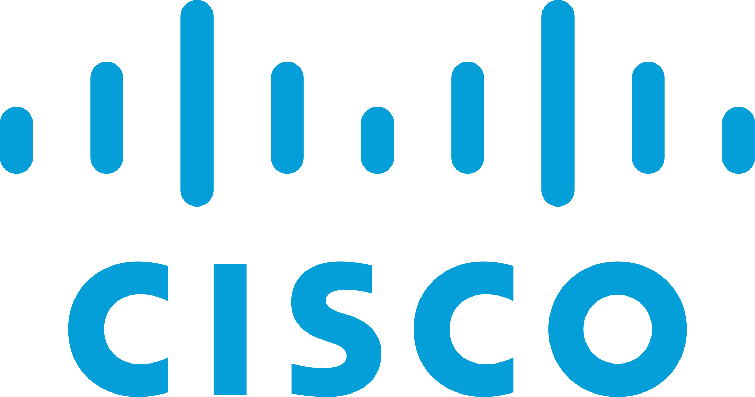



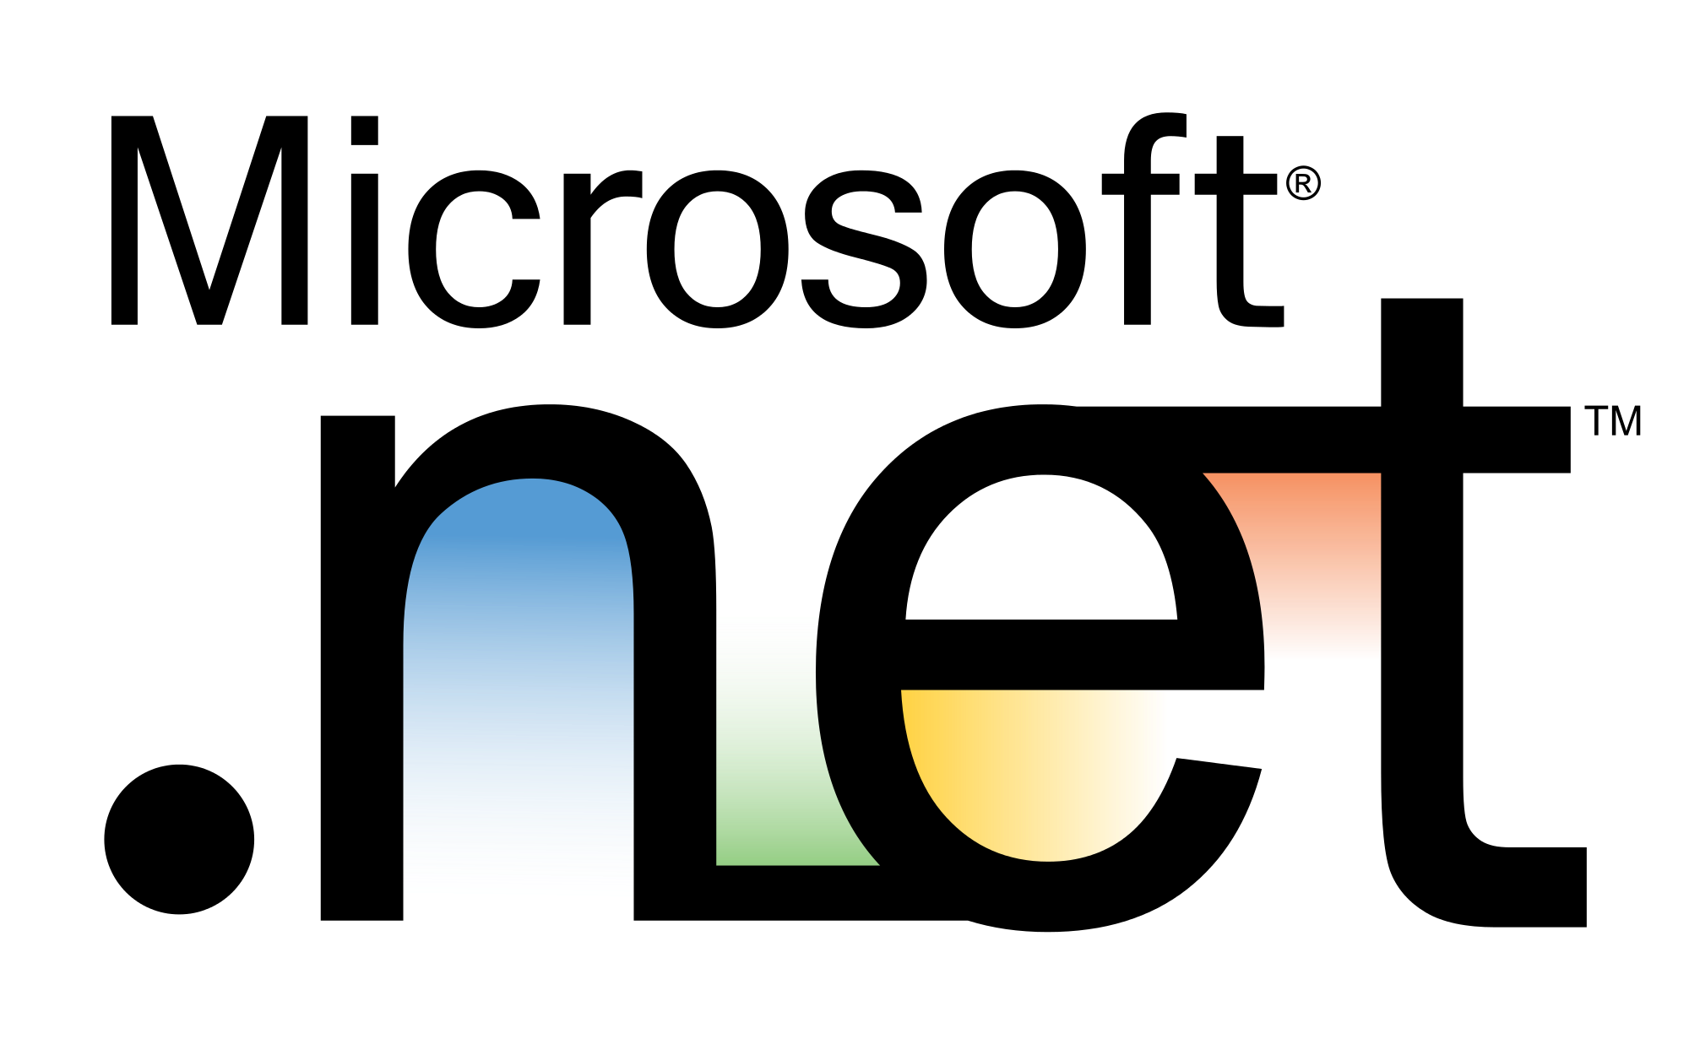
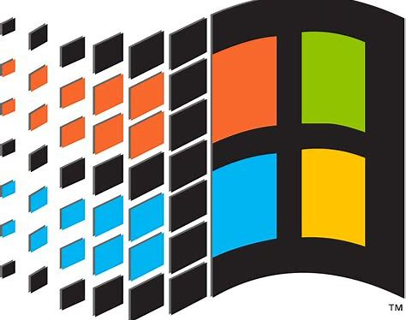



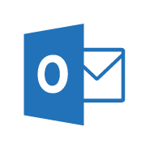

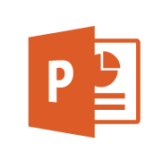
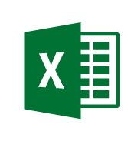
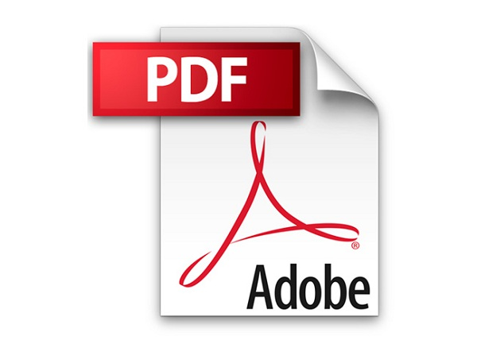

Zero Trust User Access
Legend
Full access
Limited access
Risk Mitigation
Remediation Path
December 2021 – https://aka.ms/MCRA
Conditional Access to Resources
Policy is evaluated when
Initial Access + Token Refresh
Change in security posture
Microsoft Applications
User Threat/
Risk Signals
Azure AD
Identity Protection
Leaked cred protection
Behavioral Analytics
Lower Access
Restricted session
Office 365
Dynamics 365
Microsoft Defender
for Identity
Cloud Infrastructure
Organization Policy
Azure Portal
User risk
Microsoft Defender for Cloud Apps
User/Session Risk
Linux Login
Conditional Access
Modern Applications
Hello for Business
Increase Trust by requesting MFA
Monitor & Restrict Access
Azure MFA
Multi-Factor Authentication
Microsoft Defender for Cloud Apps
Conditional Access App Control
SaaS Applications
3rd Party MFA
Security & Compliance Policy Engine
Microsoft Threat Intelligence
8+ Trillion signals per day of security context & Human Expertise
IsCompliant
Azure Active
Directory (Azure AD)
Device Attribute(s)
Azure AD B2B & B2C
Azure AD App Proxy
Legacy Apps (Secure VPN Replacement )
Partner MDM
Microsoft Intune
3rd party VPN and Remote Access Devices
{LDAP}
Remediate Leaked Credential (Requires MFA)
Microsoft Information Protection (MIP)
Microsoft Defender
for Endpoint
Device Threat/
Risk Signals
Documents
Device risk
Azure AD Self Service Password Reset (SSPR)
Microsoft Intune
(MAM functionality)
Mobile Apps
Active Directory
IsManaged
Approved Apps
Signal
to make an informed decision
Decision
based on organizational policy
Enforcement
of policy across resources
Notes:
Key Takeaway: User Access is often the first priority for Zero Trust because it rapidly brings productivity benefits and security coverage for key gaps
Enabling users to be productive anywhere and secure requires explicit validation of user and device risk/trustworthiness using high quality signals.
CLICK 1 – User Risk
Measuring user risk requires analyzing the risk of the account itself, the current access request session, and whether they are using MFA:
User/Session Risk - Azure Active Directory (Azure AD) Identity Protection analyzes the user account and current access request, providing a high/medium/low risk rating to Azure AD conditional access. This rating is determined by a machine learning calculation across numerous individual risk factors including leaked credentials, atypical travel, malicious IP address, malware-linked IP address, and suspicious inbox manipulation rules (provided by Microsoft Defender for Cloud Apps). For information on risk levels, see https://docs.microsoft.com/azure/active-directory/identity-protection/concept-identity-protection-risks
Multi-factor authentication (MFA) – MFA is required for reasonable security assurances because attackers can (easily) impersonate an account that is protected by password-only authentication through stolen or guessed passwords. Azure AD conditional access identifies if the user has been authenticated by MFA using Azure AD MFA, Hello for Business, or a 3rd party MFA provider (via ADFS)
CLICK 2 – Device Risk
Device risk is measured by explicitly verifying whether it is compliant with the organization’s policies, which can include verification that no malicious activity has been detected from the installed endpoint detection and response (EDR) capability.
IsCompliant – Microsoft Endpoint Management Intune provides management of device security policy that evaluates signals from Intune managed clients, Microsoft Defender for Endpoint, and partner MDMs.
Device Attribute – Conditional Access can filter policies so they require a specific device attribute (e.g. to identify highly secured privileged access workstations or PAWs) - https://docs.microsoft.com/azure/active-directory/conditional-access/concept-condition-filters-for-devices
CLICK 3 – Policy Evaluation and MFA
Azure AD Conditional Access evaluates these signals against the policy you have configured. This combination of static policies and dynamic real-time information (threat intelligence, session context, etc.) provides an adaptive approach to managing risk that is both consistent and informed by continuously changing real-world conditions.
Initial Access + Token Refresh – For all applications using conditional access, policy validation happens at the time of each access request + when the token is refreshed to extend the expiration time.
Change in security posture - Additionally, conditional access supports Continuous Access Evaluation (CAE) to provide faster responsiveness to changing risk conditions in near-realtime (e.g. network location change, user termination, or potential credential theft event). This is currently supported by a few key applications like Exchange Online, SharePoint Online, and Teams.
For more information, see https://docs.microsoft.com/azure/active-directory/conditional-access/concept-continuous-access-evaluation
CLICK 4 – Remediation of High Risks
If user/session risk is rated as high (indicating that the credentials are likely/known to be compromised), you can configure the user to be automatically redirected to self-service password reset (SSPR) site to immediately change their password.
For more information, see https://docs.microsoft.com/azure/active-directory/authentication/tutorial-risk-based-sspr-mfa
CLICK 5 – First Integrations (Microsoft Applications and 3rd party VPN and Network Devices)
After explicitly validating that the user/session and device risk is low enough, access is granted access to the resource.
The first integrations are usually:
Microsoft Applications, as these cloud applications natively support Azure AD and Conditional Access.
3rd Party VPN and Remote Access Devices - to rapidly increase security for remote access of your applications and network for remote and hybrid work senarios. This quickly adds sophisticated user and device risk validation authentication which mitigates common password and device risks.
Many vendors support Azure AD authentication including Cisco AnyConnect, Palo Alto Networks GlobalProtect and Captive Portal, F5, Fortinet FortiGate SSL VPN, Citrix NetScaler, Zscaler Private Access (ZPA), Azure VPN AAD, and more.
For more information on these, see https://docs.microsoft.com/azure/active-directory/saas-apps/tutorial-list
CLICK 6 – Enable your Enterprise Estate
Next, we expand to your full estate of enterprise applications across cloud, mobile, and on-premises applications
CLICK 7 – Legacy Applications and Session Monitoring
Azure AD App Proxy provides the ability to publish legacy on-premises applications to take advantage of these strong assurances (and also simplify user experience) that can help you move Beyond VPN
Microsoft Defender for Cloud Apps (Conditional Access App Control) also enables Session Monitoring and Restrictions. You can monitor sessions and restrict functionality with session policies based on signals from conditional access and other MDCA detections within the session including:
Prevent data exfiltration
Protect on download
Prevent upload of unlabeled files
Monitor user sessions for compliance
Block access
Block custom activities
For more information on MDCA CAAC, see https://docs.microsoft.com/cloud-app-security/proxy-intro-aad
Additional Information
Lower Access – You can restrict access to aspects of the application or data in it using native application features like this SharePoint site restriction on downloading, printing, or syncing files - https://docs.microsoft.com/sharepoint/control-access-from-unmanaged-devices

Slide 40
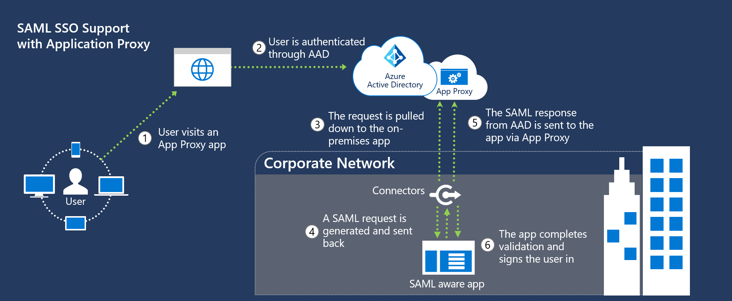
Azure AD Application Proxy
Notes:
Application Proxy is a feature of Azure AD that enables users to access on-premises web applications from a remote client. Application Proxy includes both the Application Proxy service which runs in the cloud, and the Application Proxy connector which runs on an on-premises server. Azure AD, the Application Proxy service, and the Application Proxy connector work together to securely pass the user sign-on token from Azure AD to the web application.
Application Proxy works with:
Web applications that use Integrated Windows authentication for authentication
Web applications that use form-based or header-based access
Web APIs that you want to expose to rich applications on different devices
Applications hosted behind a Remote Desktop Gateway
Rich client apps that are integrated with the Microsoft Authentication Library (MSAL)
Application Proxy is recommended for giving remote users access to internal resources. Application Proxy replaces the need for a VPN or reverse proxy. It is not intended for internal users on the corporate network. These users who unnecessarily use Application Proxy can introduce unexpected and undesirable performance issues.
Like most Azure AD hybrid agents, the Application Proxy Connector doesn't require you to open inbound connections through your firewall. User traffic in step 3 terminates at the Application Proxy Service (in Azure AD). The Application Proxy Connector (on-premises) is responsible for the rest of the communication.

Slide 41
Demo

Slide 42
Q & A

Slide 43
Thank you!!

